Slide 1


HOPE FOR
SUDAN
By Khalid Tajelsir & Mohammed Abdelkhalig
page 01

Slide 2
An Interactive Recovery Platform
Helps map war-damaged areas in Sudan
Uses AI to analyze satellite images
Allows citizens to report needs and services
Supports NGOs and government in planning recovery
page 02

Slide 3

The Problem We Are Solving
No centralized platform for recovery data
Citizens disconnected from planning
Humanitarian efforts lack coordination
Difficulty in knowing which areas need help most
page 03

Slide 4

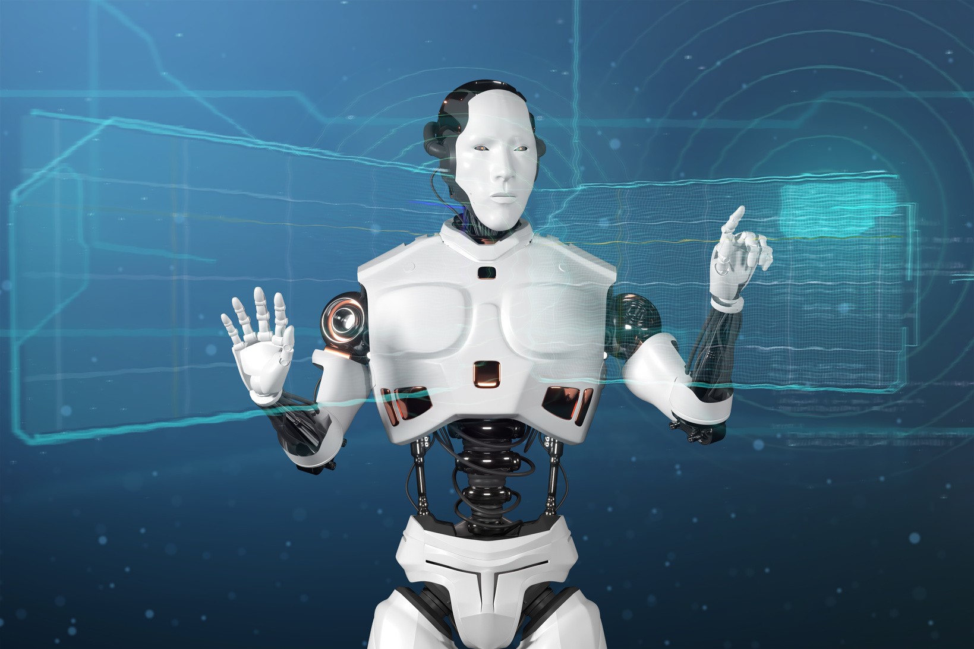
Our Main Objectives
Build a live, interactive map of affected and recovered areas
Enable public to report on-ground conditions
Use AI to compare before/after satellite images
Help prioritize needs based on citizen votes
page 04

Slide 5
Who Will Use the Platform
Government agencies and planners
Local and international NGOs
Citizens affected by war
Volunteers and tech communities
page 05

Slide 6


System overview
1.
2.
3.
Collects satellite images and user reports
AI analyzes destruction and recovery
Interactive map shows updated results
page 06

Slide 7


studio shodwe
1.
Front-end
React.js, Bootstrap, Leaflet.js
Modern Tools and Frameworks
2.
Back-end
PHP (Laravel), RESTful APIs
3.
AI Tools
Python (TensorFlow, OpenCV)
4.
Database
PHP (Laravel), RESTful APIs
page 07
www.reallygreatsite.com

Slide 8
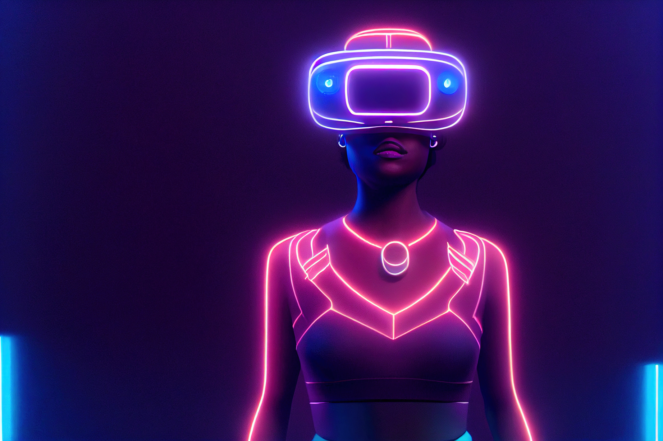
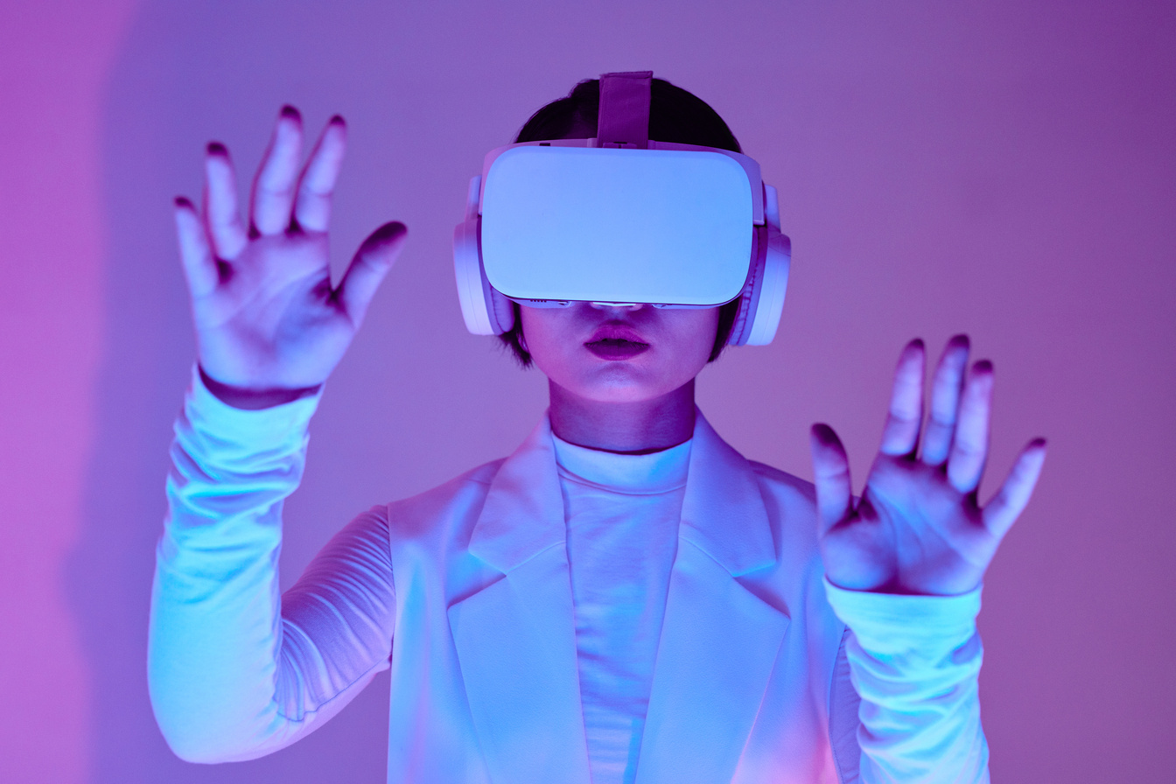
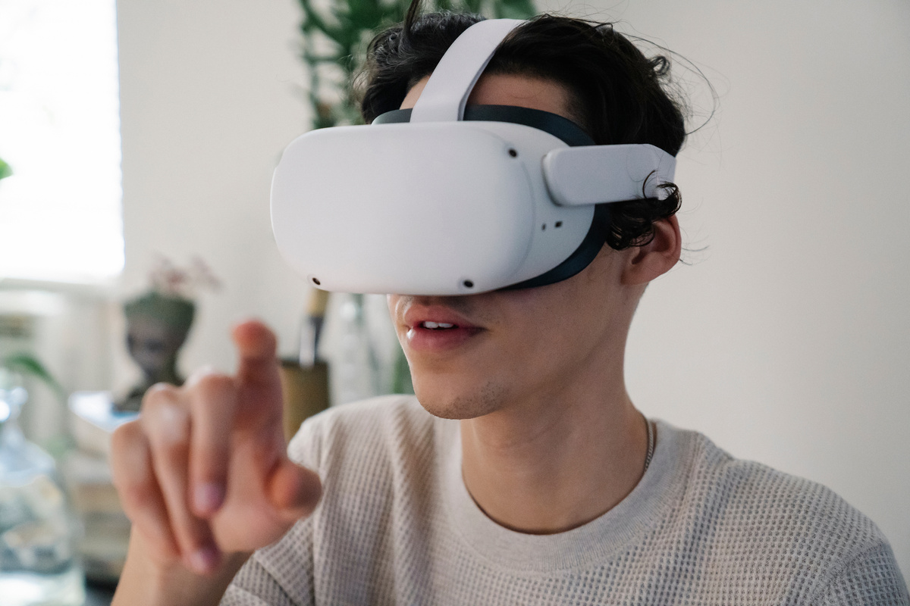
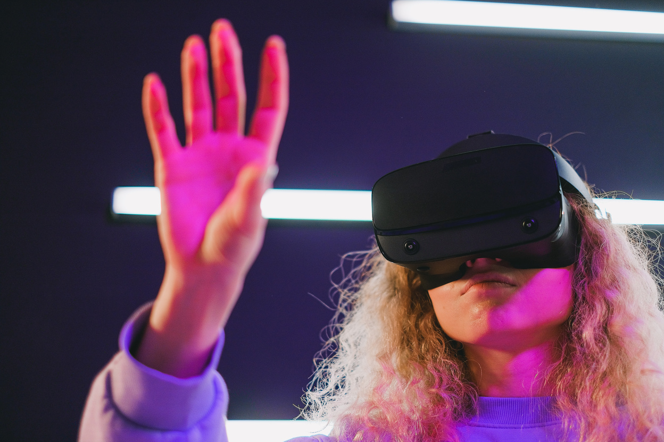
studio shodwe
VIRTUAL REALITY
Virtual Reality (VR) is extending its reach beyond gaming into areas like education, healthcare, and entertainment. By creating immersive, interactive experiences, VR has the potential to revolutionize how we learn, train, and even treat medical conditions. As the technology continues to improve, VR is expected to become an integral part of various industries, offering new ways to engage and experience the world.
page 06
www.reallygreatsite.com

Slide 9


studio shodwe
SPACE EXPLORATION
Space exploration is entering a new era, driven by advances in technology and a renewed interest in reaching beyond our planet. From ambitious missions to Mars to the development of space tourism, these efforts are expanding our understanding of the universe and pushing the boundaries of what humanity can achieve. The future of space exploration holds the promise of new discoveries and the potential for human settlement on other planets.
page 06
www.reallygreatsite.com

Slide 10
studio shodwe
THANK YOU!
As we look to the future, these technologies will play a crucial role in shaping a better world for generations to come.
page 10
www.reallygreatsite.com

